Slide 1
MEASURING INSTRUMENTS
UNIT-IV

Slide 2
MEASURING INSTRUMENTS:
“The device used for comparing the unknown quantity with the unit of measurement or standard quantity is called a Measuring Instrument.”

Slide 3
CLASSIFICATION OF INSTRUMENTS:
Basically Electrical instruments may be divided into two categories, they are;
Absolute instruments,
Secondary instruments.
- Absolute instruments gives the quantity to be measured in term of instrument constant & its deflection. The value of the quantity cannot be read directly from an absolute instrument.
Ex: Tangent galvanometer
-In Secondary instruments the deflection or direct reading gives the magnitude of electrical quantity to be measured directly. These instruments are required to be calibrated by comparing with another standard instrument before putting into use.
Ex: Ammeters, Volt meters ,Watt meters

Slide 4

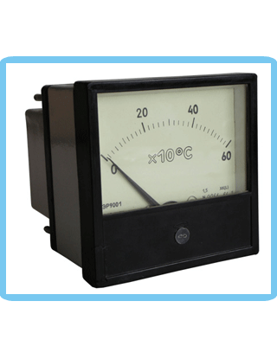
CLASSIFICATION OF INSTRUMENTS:

Slide 5
CLASSIFICATION OF INSTRUMENTS:
Electrical measuring instruments may also be classified according to the kind of quantity, kind of current, principle of operation of moving system.
CLASSIFICATION OF SECONDARY INSTRUMENTS:
Secondary instruments can be classified into three types;
i. Indicating instruments;
ii. Recording instruments;
iii. Integrating instruments.

Slide 6
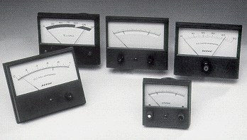
CLASSIFICATION OF SECONDARY INSTRUMENTS
Indicating Instruments:
It indicate the magnitude of an electrical quantity at the time when it is being measured. The indications are given by a pointer moving over a graduated dial.
Ex: 1)Volt meter
2)Ammeter
3)Watt meter

Slide 7
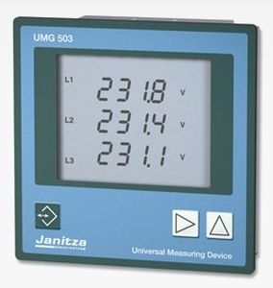
Recording Instruments:
The instruments which keep a continuous record of the variations of the magnitude of an electrical quantity to be observed over a defined period of time.
Ex:
1)Recording voltmeter in a substation
2)Graphic recorders
3)Galvanometer recorders

Slide 8
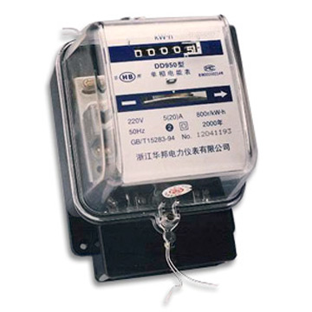
Integrating Instruments:
The instruments which measure the total amount of either quantity of electricity or electrical energy supplied over a period of time.
Ex:
1)Energy meters.
2)Ampere-hour meter

Slide 9
OPERATING PRINCIPLES:
Electrical measuring instruments needs a force on the moving system to indicate the quantity being measured. This force may be due to one of the several effects as:
:
TYPE OF EFFECT | TYPES OF INSTRUMENTS UTILIZING THE EFFECT
Magnetic effect | Most electrical instruments such as Ammeters, Voltmeters and Watt meters etc.
Electromagnetic induction | AC ammeters ,Volt meters ,Watt meters etc.
Heating effect | AC and DC ammeters and volt meters.
Chemical effect | DC ampere-hour meters.
Electrostatic | Voltmeters ,indirect applications in ammeters and watt meters.
The first two effects of current and voltage are commonly applied in measuring
Instruments.

Slide 10
ESSENTIALS OF INDICATING INSTRUMENTS :
Indicating instruments are those which indicate the value of quantity that is being measured at the time at which it is measured. Such instruments consist essentially of a pointer which moves over a calibrated scale & which is attached to a moving system pivoted in bearing. The moving system is subjected to the following three torques:
1. A deflecting ( or operating) torque;
2. A controlling ( or restoring) torque;
3. A damping torque.

Slide 11
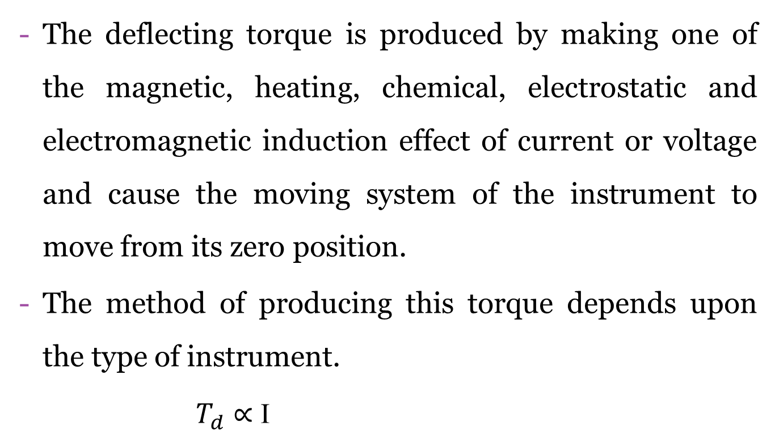
DEFLECTING TORQUE (DELECTING SYSTEM):

Slide 12
CONTROLLING TORQUE (CONTROLLING SYSTEM):
The magnitude of the moving system would be some what indefinite under the influence of deflecting torque, unless the controlling torque existed to oppose the deflecting torque.
It increases with increase in deflection of moving system.
Under the influence of controlling torque the pointer will return to its zero position on removing the source producing the deflecting torque.
Without controlling torque the pointer will swing at its maximum position & will not return to zero after removing the source.

Slide 13
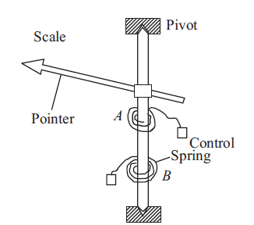
Controlling torque is produced either by
i)spring control method ii) gravity control method.
I)SPRING CONTROL:
When the pointer is deflected
one spring unwinds itself while
the other is twisted. This twist in
the spring produces restoring
(controlling) torque, which is
proportional to the angle of
deflection of the moving systems.

Slide 14
In Spring Control controlling torque
As we know that Deflecting torque
At equilibrium condition
∴ θ ∝ I
It is clear that in instruments employing spring control ,the scale
is uniform or linear

Slide 15
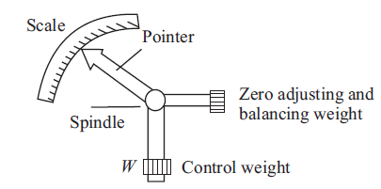
ii)Gravity Control
In gravity controlled instruments, a small adjustable weight is attached to the spindle of the moving system such that the deflecting torque produced by the instrument has to act against the action of gravity.
Thus a controlling torque is obtained. This weight is called the control weight. Another adjustable weight is also attached is the moving system for zero adjustment and balancing purpose. This weight is called Balance weight.

Slide 16
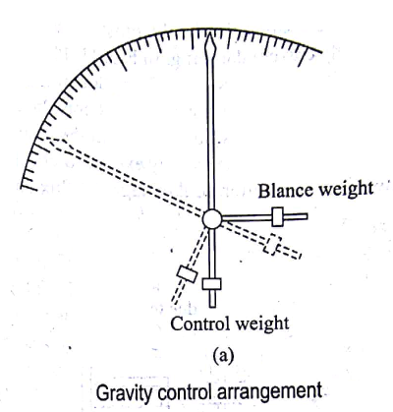
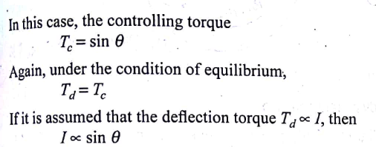

Slide 17
DAMPING TORQUE (DAMPING SYSTEM):
We have already seen that the moving system of the instrument will tend to move under the action of the deflecting torque.
But on account of the control torque, it will try to occupy a position of rest when the two torques are equal and opposite.
However, due to inertia of the moving system, the pointer will not come to rest immediately but oscillate about its final deflected position as shown in figure and takes appreciable time to come to steady state.
To overcome this difficulty a damping torque is to be developed by using a damping device attached to the moving system.

Slide 18
The damping torque is produced by the following methods:
1.Air Friction Damping
2.Fluid Friction Damping
3.Eddy Current Damping
4.Electromagnetic Damping

Slide 19
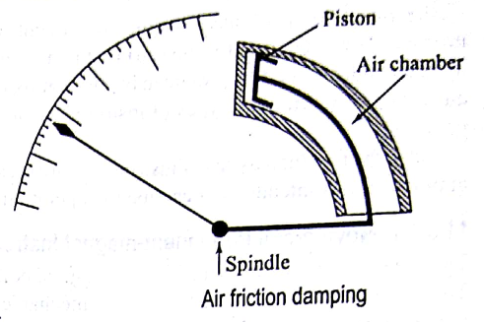
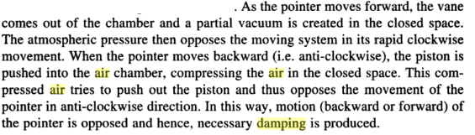
Air friction damping:
one end.
.

Slide 20
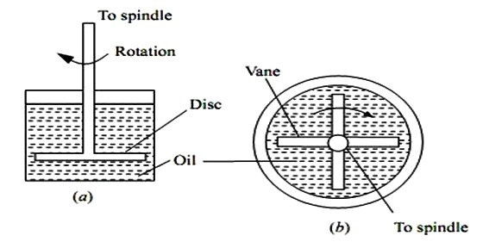
The air friction damping is very simple and cheap. But care must be taken to ensure that the piston is not bent or twisted. This method is used in moving iron and hot wire instruments.
Fluid Friction Damping
In Fig. (a) a disc attached to the moving system is immersed in the fluid (dampingoil).When the moving system moves the disc moves in oil and a frictional drag is produced. For minimizing the surface tension affect, the suspension stem of the disc should be cylindrical and of small diameter.

Slide 21
In the arrangement of Fig. (b) a number of vanes are attached to the spindle. These vanes are submerged in oil and moves in a vertical plane. This arrangement provides greater damping torque.
Advantages
1. The oil used for damping can also be used for insulation purpose in some forms of instruments which are submerged in oil.
2. The clearance between the vanes and oil chamber is not as critical as with the air friction damping system.
3. This method is suitable for use with instruments such as electrostatic type where the movement is suspended rather than pivoted.
4. Due to the up thrust of oil, the loads on bearings or suspension system is reduced thereby reducing the frictional errors.
Disadvantages 1. The instruments with this type of damping must be kept always in a vertical position.
2. It is difficult to keep the instrument clean due to leakage of oil.
3. It is not suitable for portable instruments.

Slide 22
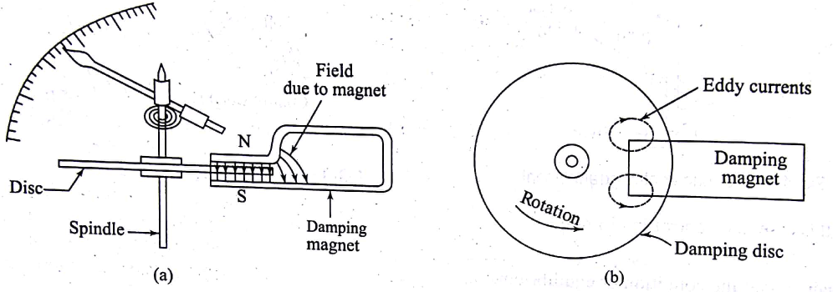
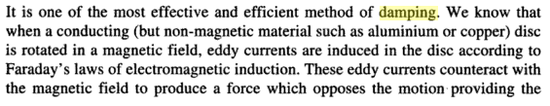
Eddy current damping:

Slide 23
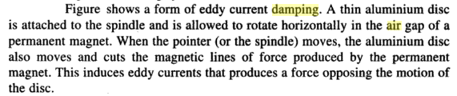

Slide 24
TYPES OF AMMETERS & VOLTMETERS
1) Moving Coil Type Meters (AC & DC);
a) Permanent Magnet type,
b) Electrodynamic or Dynamometer.
2) Moving Iron Type Meters (AC & DC);
a) Attraction type,
b) Repulsion type.
3)Induction Type (AC & DC);
a) Split phase,
b) Shaded Pole type.
4)Hot Wire Type (AC & DC);
5)Electrostatic Type for Voltmeters Only;

Slide 25
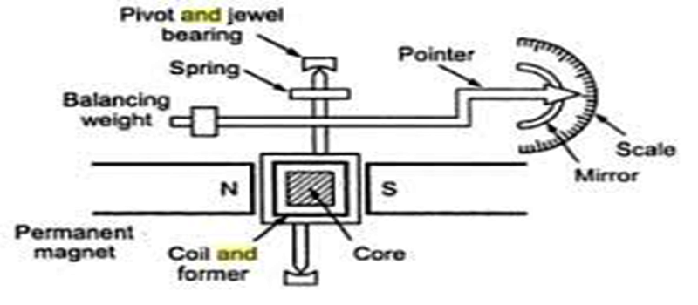
Permanent Magnet Moving Coil (PMMC)Instruments:

Slide 26
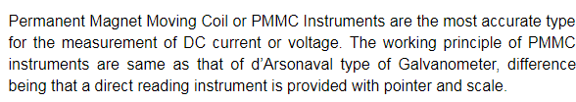
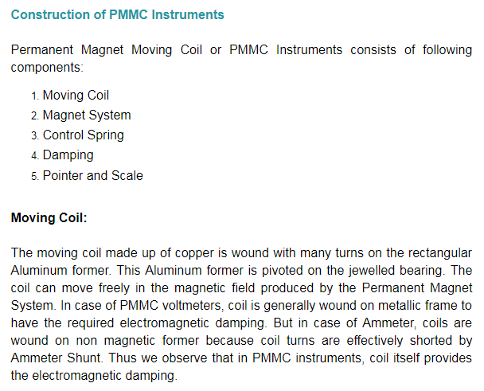

Slide 27
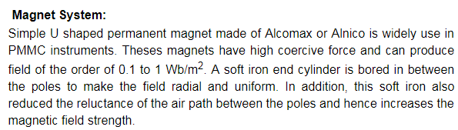
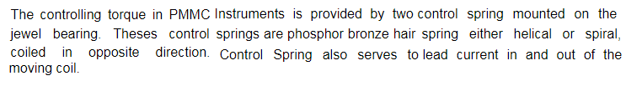
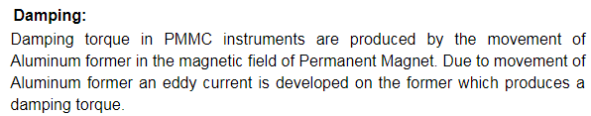

Slide 28
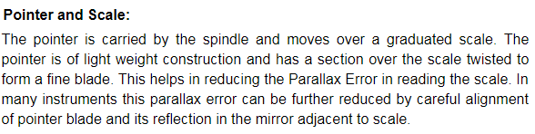
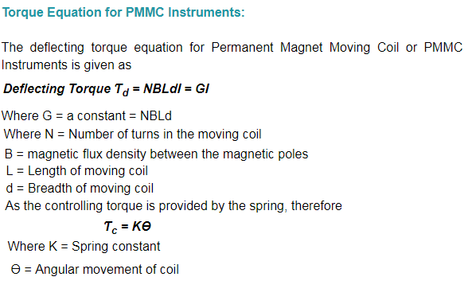

Slide 29
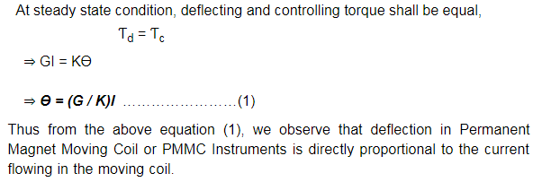
∴ θ ∝ I
Advantages of PMMC Instruments:
The PMMC consumes less power and has great accuracy.
It has uniformly divided scale and can cover arc of 270 degree.
The PMMC has a high torque to weight ratio.
It can be modified as ammeter or voltmeter with suitable resistance.
It has efficient damping characteristics and is not affected by stray magnetic field.
It produces no losses due to hysteresis.

Slide 30
Disadvantages of PMMC Instruments:
The moving coil instrument can only be used on D.C supply as the reversal of current produces reversal of torque on the coil.
It’s very delicate and sometimes uses ac circuit with a rectifier.
It’s costly as compared to moving iron instruments.
It may show error due to loss of magnetism of permanent magnet.
Moving Iron (MI) instruments:
This instrument is one of the most primitive forms of measuring and relay instrument.
Types of moving iron instruments:
Attraction type
Repulsion type

Slide 31
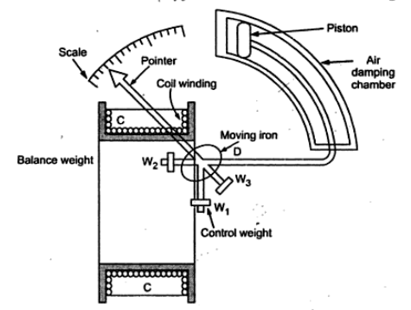
1.Attraction type moving iron instrument:
Construction of the attraction type moving iron instrument is as shown in the given figure .
The moving iron, i.e. the disc of soft iron, is eccentrically mounted. Coil is situated around the disc. When the coil is excited it produces magnetic field. .

Slide 32
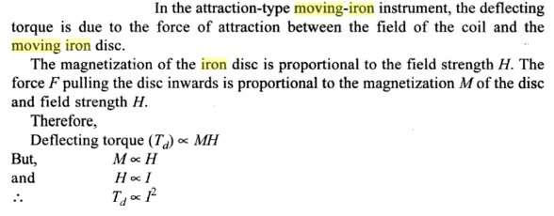
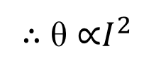
Due to magnetic field the moving iron moves from the weaker field outside the coil to the stronger field inside the coil. Thus moving iron gets attracted inwards and thus the name attraction type
The controlling torque is provided by the balance weights attached to the moving iron. Spring also can be used to provide controlling torque.
Damping is provided by air friction in which aluminum piston is attached to the moving system and moves in a closed air damping chamber.

Slide 33
2. Repulsion type moving iron instrument:
In these type of instruments there are two vanes present inside the coil in which one is fixed while other is movable. These both vanes gets similarly magnetized when coil is excited. Thus there is a force of repulsion between both vanes causing movement in movable vane. There are further two different designs of repulsion type moving iron instruments.
Two different designs of repulsion type instruments are:
i) Radial vane type and
ii) Co-axial vane type
i). Radial vane type:
In radial vane type radial strips of iron are used as moving vanes. The fixed vane is attached to the coil and moving is attached to the moving spindle. The strips are placed within the coil as shown in Fig.1.
ii). Co-axial vane type:
In this type of instrument, the fixed and moving vanes are sections of co- axial cylinders as shown in Fig.2.

Slide 34
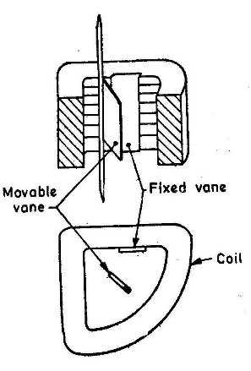
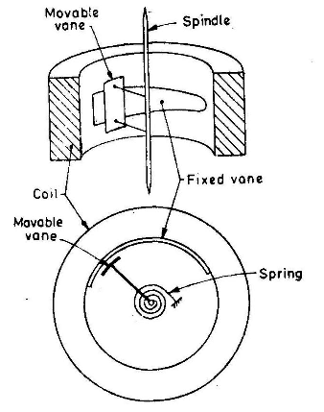
Fig.2.Co-axial vane type
Fig.1 Radial vane type

Slide 35
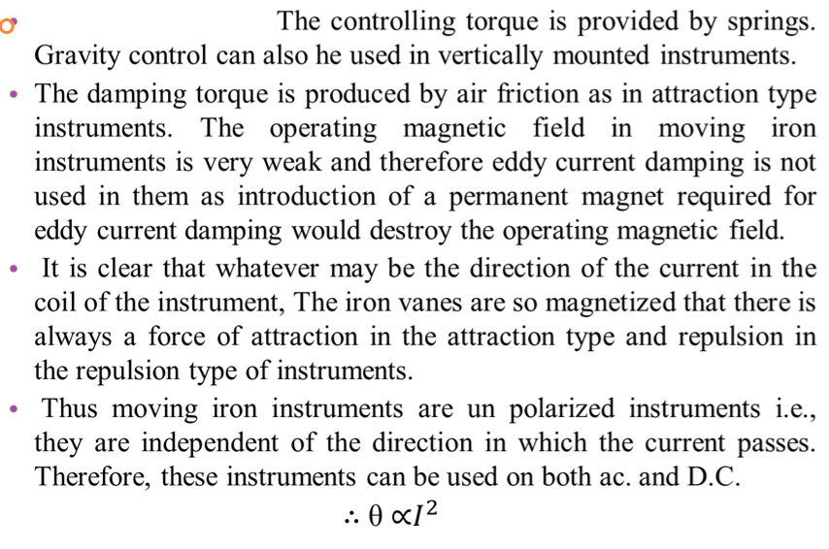

Slide 36
Advantages:
1)Can be used both in D.C. as well as in A.C. circuits.
2)Robust and simple in construction.
3)Possess high operating torque.
4)Can withstand overload momentarily.
5)Since the stationary parts and the moving parts of the instrument are simple so they are cheapest.
6)Suitable for low frequency and high power circuits.
7)Capable of giving an accuracy within limits of both precision and industrial grades.
Disadvantages:
1)Scales not uniform.
2)For low voltage range the power consumption is higher.
3)The errors are caused due to hysteresis in the iron of the operating system and due to stray magnetic field.
4)In case of A.C. measurements, change in frequency causes serious error.
5)With the increase in temperature the stiffness of the spring decreases.

Slide 37
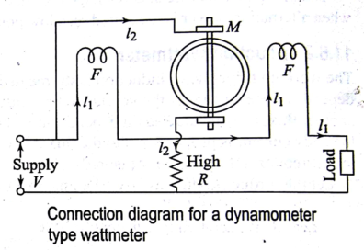
Measurement of power:
The three types of instruments used for measurement of power are a)Dynamometer wattmeter
b)Induction wattmeter
c)Electrostatic wattmeter
Dynamometer wattmeter:

Slide 38
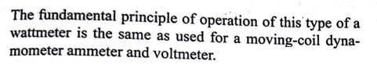
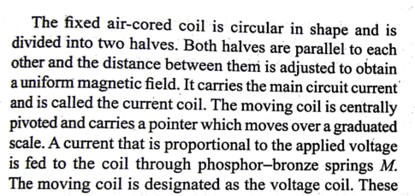

Slide 39
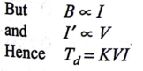
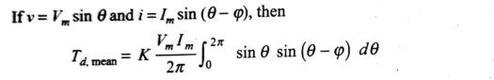
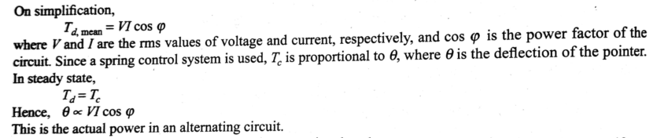
∴ θ ∝ Power

Slide 40
Induction type wattmeter:
Such instruments are suitable for ac measurements only in these instruments the deflecting torque is produced by the eddy currents induced in an aluminum or copper disc or drum by the flux created by an electro-magnet.
The main advantages of such instruments are that
(i) a full scale deflection can be obtained giving long and open scale
(ii) the effect of stray magnetic field is small;
(iii) damping is easier and effective.

Slide 41
These instruments have got some serious disadvantages
(i) The greater deflection causes more stresses in the control springs.
(ii) Variation in supply frequency and temperature may cause serious errors unless compensating device is employed.
(iii) These instruments are costlier and consume more power
Such instruments are mostly used as watt-meters or energy meters.

Slide 42
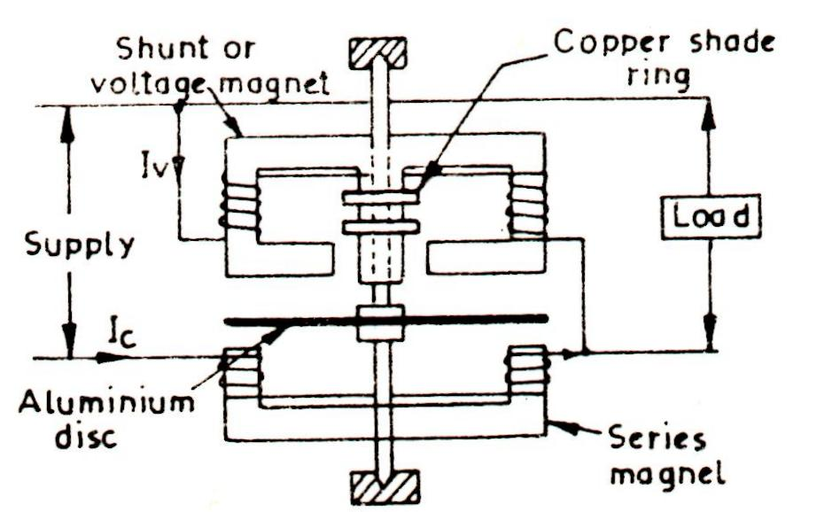

Slide 43
Induction type wattmeter consists of two laminate electromagnets known as shunt electromagnet and series electromagnet respectively.
Shunt magnet is excited by the current proportional to the voltage across load flowing through the pressure coil and series magnet is excited by the load current flowing through the current coil.
A thin disc made of Cu or Al, pivoted at its centre, is placed between the shunt and series magnets so that it cuts the flux from both of the magnets.
The deflection torque is produced by interaction of eddy currents induced in the disc and the inducing flux.

Slide 44
In order to cause the resultant flux in shunt magnet to lag in phase by exactly 90° behind the applied voltage, one or more copper rings, known as copper shading bond are provided on one limb at the shunt magnet.
Correct disc appointed between shunt and series magnet fluxes may be attained by adjusting the position of copper shading bonds.
The pressure coil circuit of induction type instrument is made as inductive as possible so that the flux of the shunt magnet may lag by 90° behind the applied voltage.

Slide 45
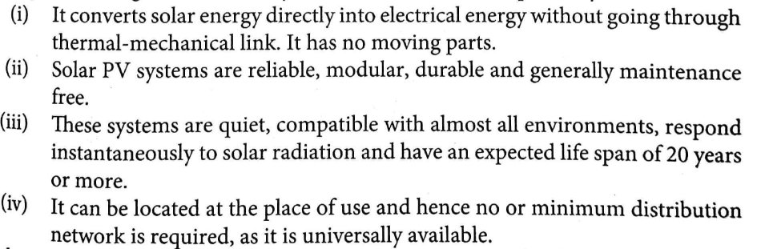
SOLAR PHOTOVOLTAIC(PV) SYSTEMS:
Solar photovoltaic(PV) systems converts solar energy directly into electrical energy. Basic conversion device used is known as a solar photo voltaic cell (or) solar cell.
Advantages of solar PV systems:

Slide 46
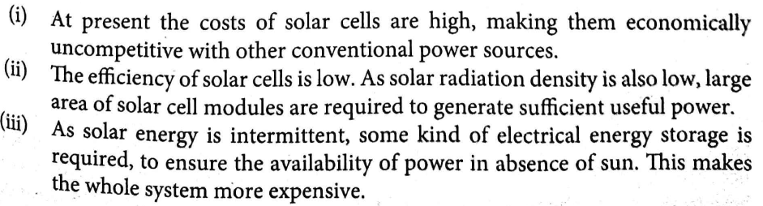
Disadvantages of solar PV systems:
SOLAR CELL FUNDAMENTALS:
1)Electric current conduction in semi conductors:
A semi conductor is an element with an electrical properties between those of a conductor and an insulator. There fore best semi conductors(Si&Ge)have four valance electrons. An isolated Si has 14 protons and 14 electrons and the outer most orbit (valance orbit)contain 4 electrons, when silicon atom combine to form a solid , they arrange themselves in to an orderly pattern called crystal.
Each silicon atom shares its electrons with four neighboring atoms in such a way as to have eight electrons in its valance orbit. Thus each pair of electrons belongs to two neighboring atoms and attracted by them with equal and opposite forces ,keeps them bonded together such a chemical bond is known as covalent bond.

Slide 47
At absolute temperature, a semiconductor is a perfect insulator with no charge carriers available for conduction of current.
However, when temperature increased, the vibration of atoms can dislodge an electron from the valance orbit .The dislodged electron is known as free electron and the vacancy created in the valance orbit is known as a hole. Thus with the breaking of covalent bond, a free electron-hole pair is produced.
Occasionally, a free electron will approach a hole, feel its attraction and fall into it. This merging of free electron and a hole is known as recombination. The amount of time between creation and disappearance (due to recombination) of an electron-hole pair is called life time.
At any instant ,following conditions exist with Si crystals.
i)Some free electrons-holes are being created
ii)Some free electrons-holes are being recombined
iii)Some free electrons and holes exist temporarily ,awaiting recombination.

Slide 48
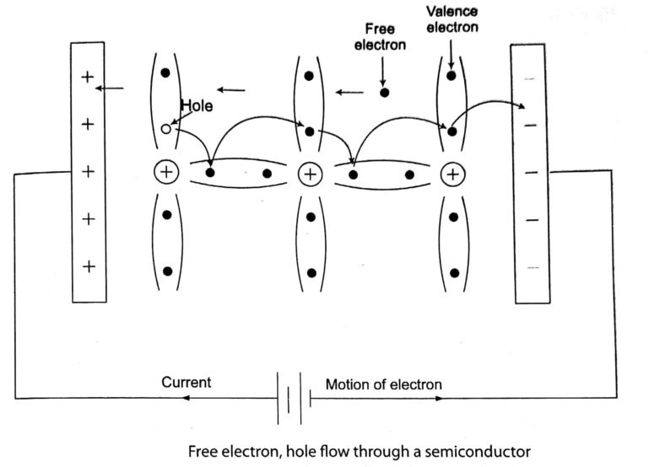
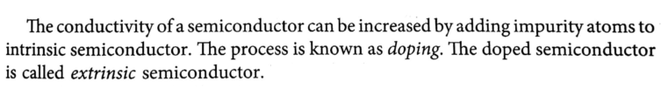

Slide 49
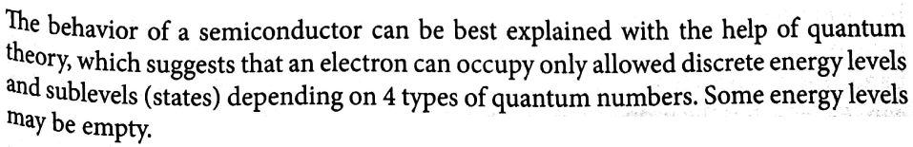
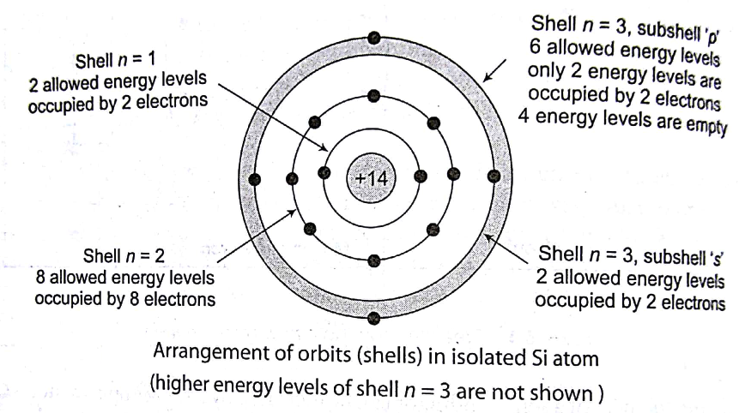
2)Arrangement of electrons in an isolated Si atom :

Slide 50
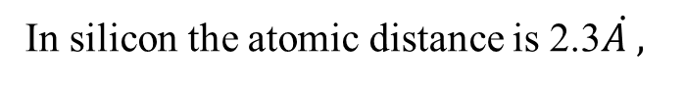
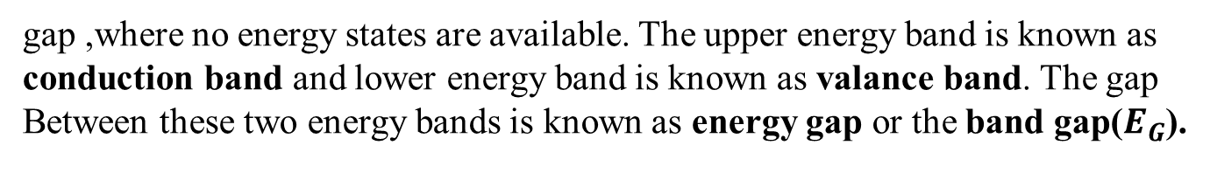
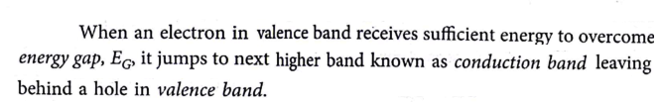
3)Formation of Energy bands:
In a crystal where many atoms are brought together, the splitting of energy levels
results in almost continuous set of energy levels, which is called energy band.
two energy bands exists, separated by

Slide 51
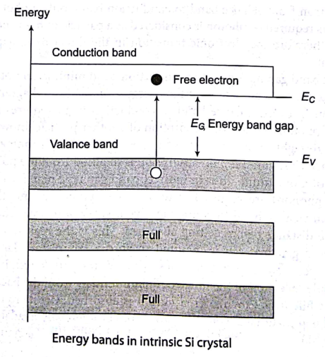

Slide 52
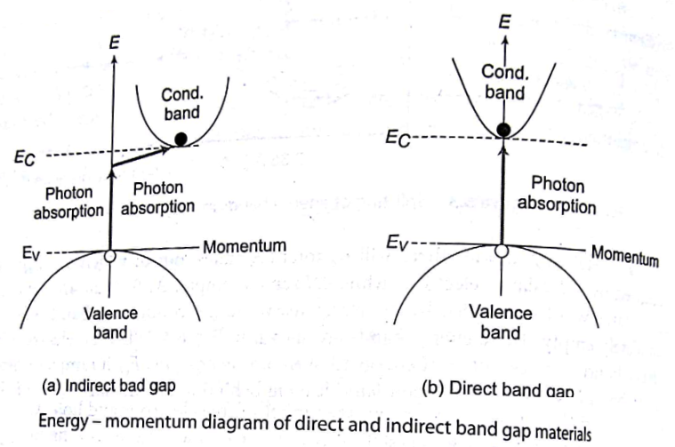
4)Direct and indirect band gap materials:
The energy bands are plotted as energy versus distance. depending on the shape
of these energy bands there are to types i)Direct ii)Indirect energy band gaps.

Slide 53
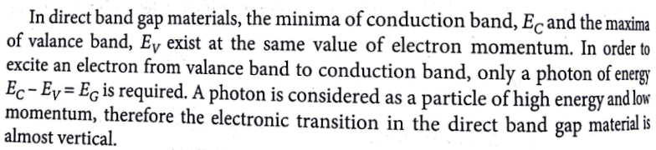
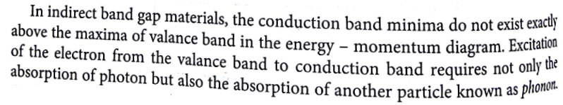
5)Energy band model of a semi conductor:
An ideal semi conductor with no lattice defects and no impurity is known as
intrinsic semi conductor. At 0 K, all allowable energy states in the valance band
are filled with electrons and no allowable energy state in conduction band is
occupied. Hence no conduction takes place.

Slide 54

Now as the temperature increases , some of the covalent bonds are broken
and electrons become free. In these process thermally excited electrons get enough
Energy to jump to conduction band. the excited electron leaves behind a vacant
Space(hole), which is filled by another electron. The excited electron in conduction
band and corresponding hole in valance band is known as electron hole pair(EHP).

Slide 55


Slide 56


SOLAR CELL CHARACTERISTICS: (I-V Characteristics)

Slide 57



Slide 58



Slide 59




Slide 60



FILL FACTOR(FF):
Fill factor is the ratio of peak power to the product of open circuit voltage and short circuit current. FF indicates the quality of the cell. Fill factor is also known
as curve factor.
=
FF=
Ideal cell has its value of unity .but commercial silicon cell is in the range of 0.5
to 0.83.

Slide 61



Slide 62


Slide 63


SOLAR CELL CLASSIFICATION:

Slide 64


i)On the basis of thickness of active material:
ii)On the basis of Junction structure:
In hetero junction cell ,the semi conductor material on both sides of the junction
is not same .thus the band gap is not same throughout the cell materials.

Slide 65

A Multi junction structure is a clever way to absorb more photon energy is to stack
junctions of different band gaps .The top junction has relatively wide band gap
followed by one or two more junctions in decreasing order of band gaps ,in tandem
(series).
When a contact is made between metal and semi conductor ,either an ohmic contact(permitting bi-directional current)or a rectifying contact(permitting unidirectional current) is formed depending on the work functions of metal and semi conductor .The rectifying contact is known as schottky junction.
A P-i-N type (P type-intrinsic-N type)junction structure ,where intrinsic silicon is
Interposed between N and P layers. The P-i-N structure is used in amorphous silicon
solar cells

Slide 66


iii)On the basis of Type of active material:
Depending on the type of material used for fabrication of a junction ,they are
classified as :i)Single crystal(mono crystalline)silicon cell (ii)Multi crystalline
Silicon cell (iii)amorphous silicon(a-Si) (iv)gallium arsenide cell(GaAS) (v)Copper Indium(gallium)di-Selenide cell(CIS) (vi)cadmium telluride cell(CdTe) (vii)Organic PV cell.

Slide 67


SOLAR CELL ,MODULE,AND ARRAY CONSTRUCTION:
Solar Cell:

Slide 68


(b)Construction of bulk silicon cell

Slide 69



Solar PV Module:

Slide 70


Cell Mismatch in a Module:
Solar PV Panel and Solar PV Array:
Solar panel is a group of several modules connected in series-parallel combination in a frame that can be mounted on a structure. Several solar modules are connected in series/parallel to increase the voltage/current ratings.
Cell ,module and Panel

Slide 71


Series-parallel connection of modules

Slide 72

A large number of interconnected solar panels, known as solar PV array, are installed in an array field. These panels may be installed as stationary or with sun tracking mechanism.
MAXIMISING THE SOLAR PV OUTPUT AND LOAD MATCHING:

Slide 73


MAXIMUM POWER POINT TRACKER:

Slide 74



Slide 75


Where D is the duty cycle of the MOSFET , expressed as fraction(0<D<1).

Slide 76



Slide 77
BALANCE OF SYSTEM (BOS) COMPONENTS:
In balance of system (BOS)includes components other than PV panel. These are batteries, charge, charge controllers, MPPT, Inverter, mounting material for the module, wire and all wiring components (Including distribution panel, junction box and miscellaneous connectors), lightning arrestors, grounding connections, battery fuses, battery cables and battery containers.
In some cases connected loads also considered as a part of BOS. Certain BOS components are regulated by codes or standards.
Batteries:
A Solar energy not available continuously and steadily, some form of energy storage is normally required in most PV Systems. Some parameters of batteries are
i) Battery voltage :Rechargeable batteries are available with nominal voltages of 3V,6V,12V,24V etc.
ii) Battery capacity: It is the maximum charge storage capacity of a battery expressed in Ah.
iii) Battery life cycle: It is defined as the number of complete charge/discharge cycles that a battery can perform before its storage capacity falls below 80 percent of its rated capacity.

Slide 78

iv) State of charge: It indicates the amount of charge available with the battery at that instant.
v) Depth of discharge: This is a measure of energy withdrawn from the battery expressed as percentage of its full capacity.
vi) Discharge rating or C-rating :It is defined as the charge or discharge current given in terms of capacity of the battery divided by number of hours for full charge or discharge.
vii)Self discharge: It is the loss of stored energy (charge) when the battery not in use.
Battery temperature during discharge and Battery charging

Slide 79

The most commonly used batteries in solar PV applications are given below

Slide 80



SOLAR PV SYSTEMS:
Solar PV systems are broadly classified as:

Slide 81



Slide 82



Slide 83



Slide 84



Slide 85


Slide 86
SOLAR PV APPLICATIONS:
1) Grid Interactive PV Power Generation
2) Water Pumping
3) Lighting
4) Medical Refrigeration
5) Village Power
6) Telecommunication and Signaling.

